Slide 1
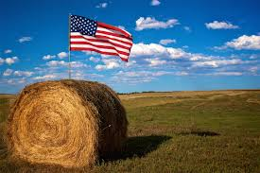
Northern Star Farms

Slide 2
ZipCode
ZipCode(PK)
State
City
Location
ID(PK)
PlaceName
PlaceAddress
ZipCode(PK)
OrderDetails
ID(PK)
OrderID(PK)
City
ProductID(PK)
1
1
1
8
8
8
Product
ID(PK)
Type
Description
PricePerBale
1
Customers
ID(PK)
Name
Phone#
StreetAddress
Email
ZipCode(FK)
Order
ID(PK)
Date CustomerID(FK)
LocationID(FK)
1
1
8
8
8

Slide 3
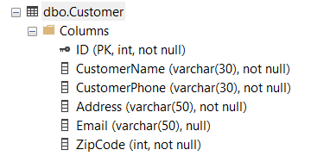
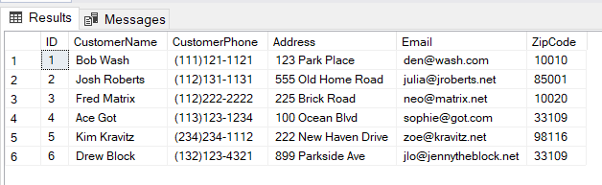
Customer Table

Slide 4
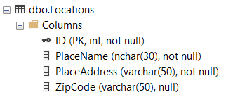
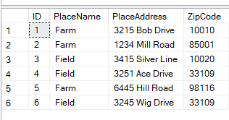
Locations Table

Slide 5
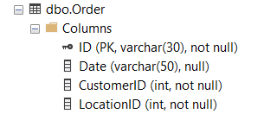
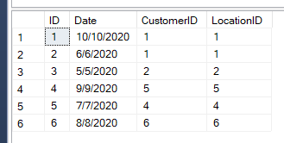
Order Table

Slide 6
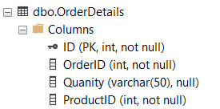
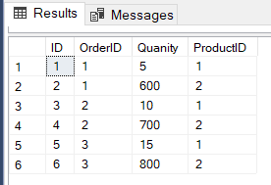
Order Details Table

Slide 7
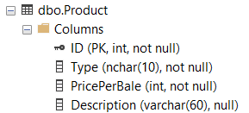
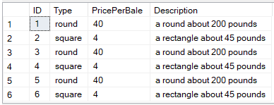
Product Table

Slide 8
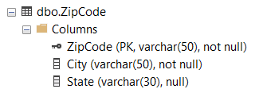
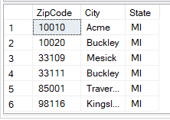
Zip Code Table

Slide 9
The End
Thank You For Watching

